Slide 1
Development of computational tools for physics experiments using python done by B. SHIVA (22UPH130) A. ANTONY PRATHAB (22UPH131) J. JAMES ANANDH (22UPH132) K. NITHYANANTHAN (22UPH134) Under the guidance of Dr. R. JERALD VIJAY Assistant Professor

Slide 2
contents
Introduction
Project Scope
Objective
Why python in physics
Project scope
Python libraries
Key difference between two versions
Results of both versions
Features of final web-app
Conclusion

Slide 3
introduction
""The computer is just as important as the telescope was for astronomy." — Richard Feynman
Physics experiments need complex math – slow and messy by hand.
Fix it! Python automates the hard work with smart tools.
Tools Used:
NumPy – Does math super fast
Matplotlib – Draws graphs in seconds
Streamlit – Makes clickable web apps
Two versions to Use It:
Type commands (CLI) for experts
Click buttons (Web) for everyone

Slide 4
objectives
Automate Physics Experiments Simplify and speed up calculations using Python.
Provide CLI & Web Interfaces
CLI: Works only on offline. Built using IDLE.
Web: Works on both online and offline.
Built with Streamlit, interactive and user-friendly
Ensure Accuracy & Reliability Use verified formulas to reduce human errors.
Visualize Results Instantly Generate graphs using Matplotlib for better understanding.
Support Learning Through Coding Help students apply programming in real-world physics.
Design for Reuse & Expansion Modular code allows future updates or additions.

Slide 5



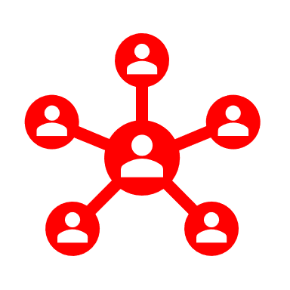
Why python in physics?
Speed
Accuracy
Application
User Interface
NumPy for complex calculations.
Reduces manual errors and can plot graphs using Matplotlib.
practical applications of numerical methods in physics..
Using Streamlit library to give you that enhance user interface.

Slide 6
Project scope
Optics: Polarimeter, Newton’s Rings, Air Wedge.
Electromagnetism: Calibration of a High-Range Voltmeter, Absolute Capacity of a Condenser, Self-Inductance of a Coil.
Mechanics: Sonometer, Young’s Modulus (Koeing’s Method, Non-Uniform Bending, Stretching Method, Uniform Bending, Cantilever Method).
Spectrometry: Spectrometer (Minimum Deviation, i-i′ Curve, Small Angle Prism).
Electrical Measurements: High Resistance by Leakage Method, Internal Resistance of a Cell, Mutual Inductance Methods.

Slide 7
Python Libraries
Library | Purpose
NumPy | Numerical calculations
Matplotlib | Graphing & Visualization
Tabulate | Formatting tables
Streamlit | Easy to create Web-based UI

Slide 8
Key difference between these two versions
Feature | Web-Based Python Programming | Standalone Python Programming
Interface | Web-based (Streamlit) | Command-line interface (CLI)
User Interaction | GUI with input fields, buttons, and visual outputs | Text-based input/output via terminal
Input Handling | Streamlit widgets (st.number_input, st.button) | input() function
Output Handling | Streamlit outputs (st.success, st.table, st.pyplot) | print() function and matplotlib for graphs
Error Handling | Explicit error handling and input validation | Limited, relies on user input validation
Program Structure | Sidebar menu for program selection | Linear text-based program selection
Flexibility | Ideal for web-based applications and sharing | Ideal for local use and batch processing
Extensibility | Easily integrated with web technologies | Easily modified for local scripts and automation

Slide 9
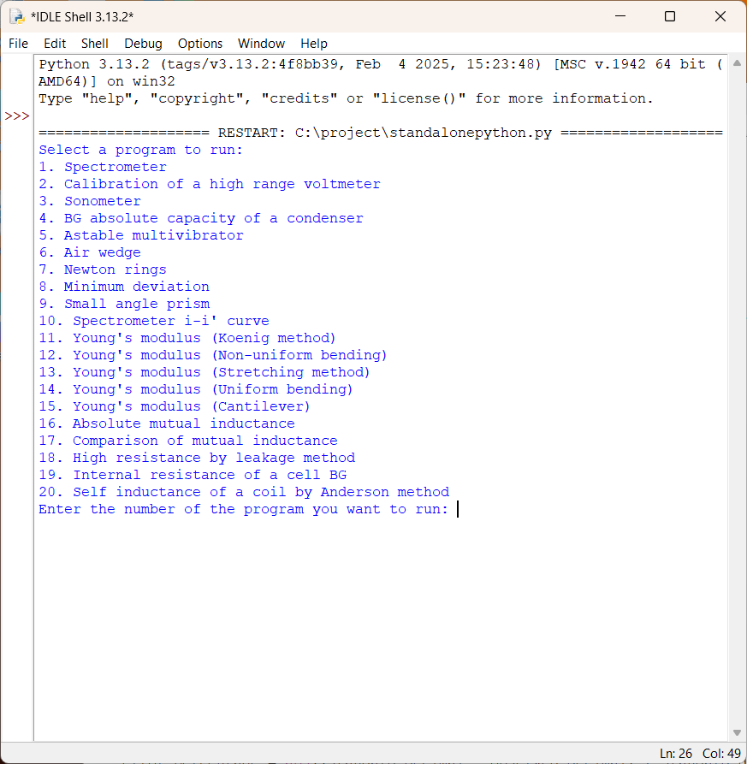
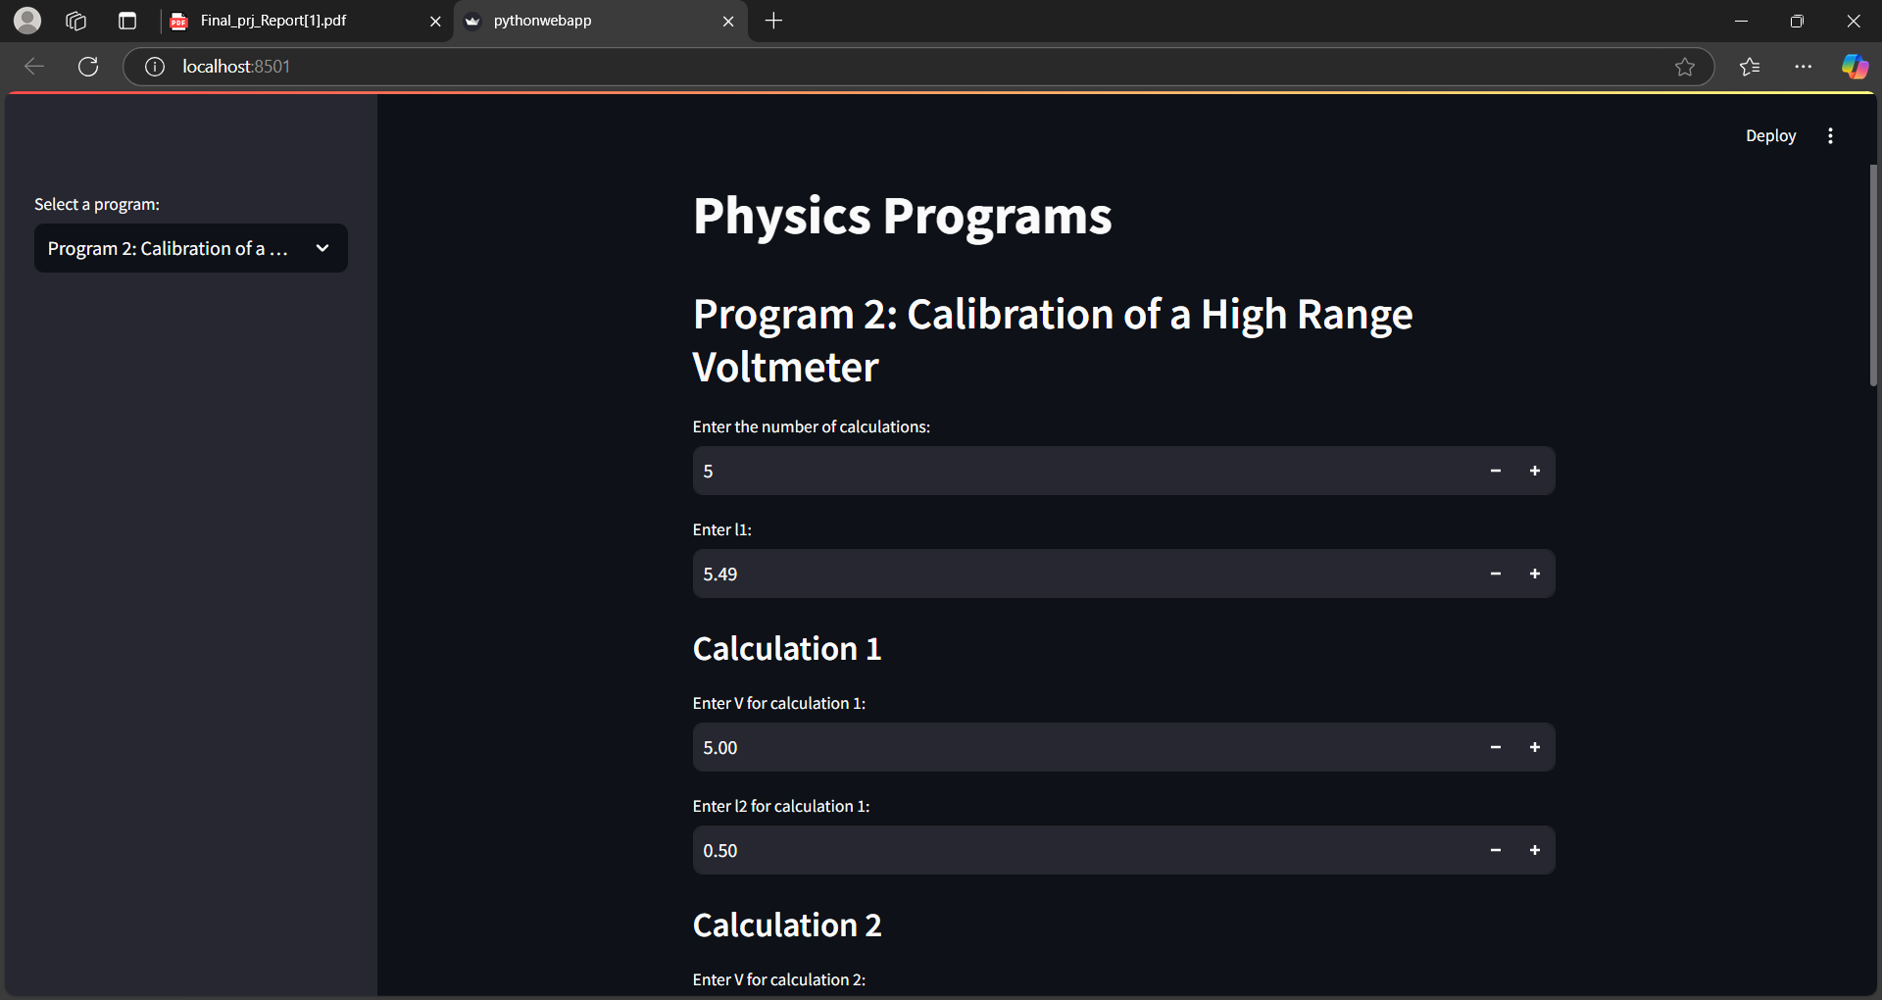
Results of both versions

Slide 10
Features of final web-app
20 Physics Experiments Covers optics, mechanics, and electronics.
Dual Interface CLI for offline use, Streamlit for a browser-based GUI.
Input Validation Catches invalid or unrealistic inputs with helpful prompts.
Instant Results Real-time output after user input, formatted clearly.
Graph Generation Visualizes data using Matplotlib (e.g., V vs. l, deflection curves).
Tabulated Output CLI version presents clean tables using the tabulate library.
Modular Code Structure Easy to update, extend, or debug—each experiment is a separate function.
User-Friendly Design Streamlit UI includes sliders, input fields, and live graphs.

Slide 11
conclusion
Built a science helper for 20+ physics experiments
Works two ways (typing OR clicking)
Spits out answers + graphs lightning fast
Code is LEGO-style – easy to add new experiments

Slide 12
Thank you

